Slide 1
Box-and-Whisker Diagram
Notes:
Title page:
Font size 36, bold, theme color of the chapter (red for geometry, blue for algebra, green for statistics)

Slide 2

Box-and-Whisker Diagram
Box-and-whisker diagram is an effective way to present important information about
a data set.

Slide 3


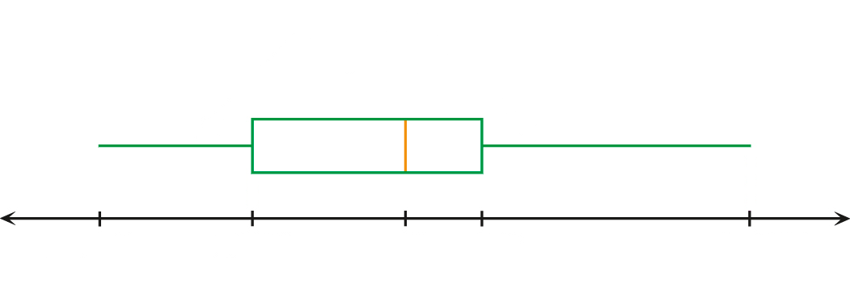
Box-and-Whisker Diagram
A box-and-whisker diagram consists of a box
and two whiskers at the two ends of the box.
whiskers
box

Slide 4
Box-and-Whisker Diagram
and the maximum values of the data
are indicated by the ends of the two whiskers.
The minimum
whiskers
box
Minimum
Maximum

Slide 5
Box-and-Whisker Diagram
The lower quartile
and the
upper quartile
are indicated by the left edge and the right edge of the box respectively.
whiskers
box
Q₁
Q₃
Minimum
Lower
quartile
Upper
quartile
Maximum

Slide 6
Box-and-Whisker Diagram
The median is indicated by a bar inside the box.
whiskers
box
Q₁
Q₂
Q₃
Minimum
Lower
quartile
Median
Upper
quartile
Maximum

Slide 7
Box-and-Whisker Diagram
Each part of the box and each whisker contains 25% of the data.
25% of the data
25% of the data
25% of the data
25% of the data
Minimum
Lower
quartile
Median
Upper
quartile
Maximum

Slide 8
Box-and-Whisker Diagram
From the diagram, we can
easily find the range
and the inter-quartile range of the data set.
Range
Inter-quartile range
Q₁
Q₂
Q₃
Minimum
Lower
quartile
Median
Upper
quartile
Maximum

Slide 9
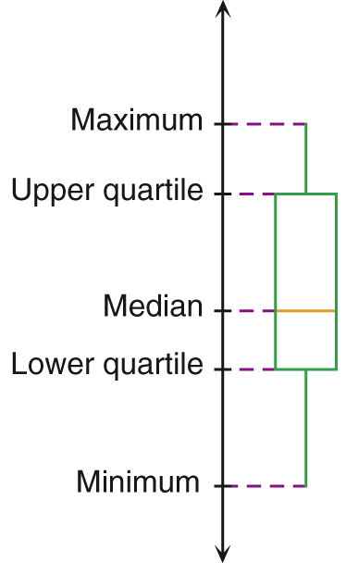

We can also draw the box-and-whisker diagram vertically.
Q₃
Inter-quartile range
Q₂
Q₁
Range

Slide 10
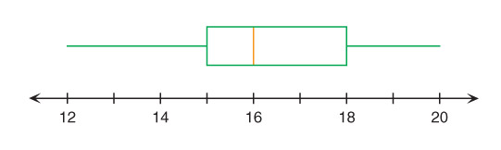


Consider the box-and-whisker diagram below:
Range
IQR
Minimum = 12
Maximum = 20
Range = 20 – 12
= 8
Min.
Q₁
Q₂
Q₃
Max.
Lower quartile (Q₁) = 15
Median (Q₂) = 16
Upper quartile (Q₃) = 18
IQR =
18 – 15 = 3
IQR = Q₃ – Q₁

Slide 11
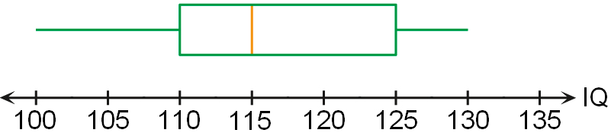
Follow-up question
The box-and-whisker diagram below shows the distribution of the IQ scores of 30 children.
(a) Find the median IQ score of the children.
(b) Find the range and the inter-quartile range of the
IQ scores of the children.
(a) Median IQ score = 115

Slide 12
Follow-up question
The box-and-whisker diagram below shows the distribution of the IQ scores of 30 children.
(a) Find the median IQ score of the children.
(b) Find the range and the inter-quartile range of the
IQ scores of the children.
(b) Range of the IQ score = 130 – 100
= 30
Inter-quartile range of the IQ scores = 125 – 110
= 15

Slide 13


How can we draw a box-and-whisker diagram when a data set is given?
Let us take the data set
1, 4, 6, 11, 17, 23, 31
as an example.

Slide 14
Data set: 1, 4, 6, 11, 17, 23, 31
Step 1
Find the lower quartile, the upper quartile, the median, the maximum and the minimum values of the data set.
Minimum = 1
Lower quartile = 4
Median = 11
Upper quartile = 23
Maximum = 31

Slide 15
Minimum = 1
Minimum = 1 Lower quartile = 4
Median = 11 Upper quartile = 23
Maximum = 31
Maximum = 31
Step 2
Draw a suitable number line covering the minimum and the maximum values.

Slide 16
Lower quartile = 4
Minimum = 1 Lower quartile = 4
Median = 11 Upper quartile = 23
Maximum = 31
Upper quartile = 23
Step 3
Draw a box with two vertical edges corresponding to the lower and the upper quartiles respectively.
Lower quartile = 4
Upper quartile = 23

Slide 17
Minimum = 1 Lower quartile = 4
Median = 11 Upper quartile = 23
Maximum = 31
Median = 11
Step 4
Draw a vertical line segment across the box at the median.
Median = 11

Slide 18
Minimum = 1
Minimum = 1 Lower quartile = 4
Median = 11 Upper quartile = 23
Maximum = 31
Maximum = 31
Step 5
Draw two horizontal line segments, one extending from the left edge of the box to the minimum value,
and the other extending from the right edge of the box to the maximum value.
Minimum = 1
Maximum = 31

Slide 19
Sometimes, a box-and-whisker diagram may look like these.
Data set A
Data set B

Slide 20
For data set A, since there is no left whisker in the box-and-whisker
diagram,
this means that the minimum
and the lower quartile of data set A are
equal.
In other words, the smallest
25% of data of data set A are all equal.
Data set A
Data set B

Slide 21
Similarly, for data set B, since there is no right whisker in the box-and-whisker
diagram,
this means that the maximum and
the upper quartile of data set B are equal.
In other words, the largest 25% of data of data set B are all equal.
Data set A
Data set B

Slide 22

Box-and-whisker diagrams are also useful to compare the central tendencies and the dispersions of two or more data sets.

Slide 23
For example:
Data set A
Data set B
From the box-and-whisker diagrams of the data sets A and B, we can see that
>
Median of A _____ Median of B
Range of A _____ Range of B
IQR of A _____ IQR of B
<
=

Slide 24
Follow-up question
The following box-and-whisker diagrams show the distributions of marks for S6A and S6B students in a test.
S6A
S6B
Marks
0
20
40
60
80
100
(a) Which class has a higher median mark?
(b) Based on the inter-quartile range, which class has a less dispersed mark distribution?

Slide 25
S6A
S6B
Marks
0
20
40
60
80
100
(a) Which class has a higher median mark?
(a) The median mark of S6A is higher than that of S6B.

Slide 26
S6A
S6B
Marks
0
20
40
60
80
100
(b) Based on the inter-quartile range, which class has a less dispersed mark distribution?
(b) Since the box for S6A is shorter, the inter-quartile range of marks for S6A is smaller. Hence, S6A has a less dispersed mark distribution.

